Slide 1
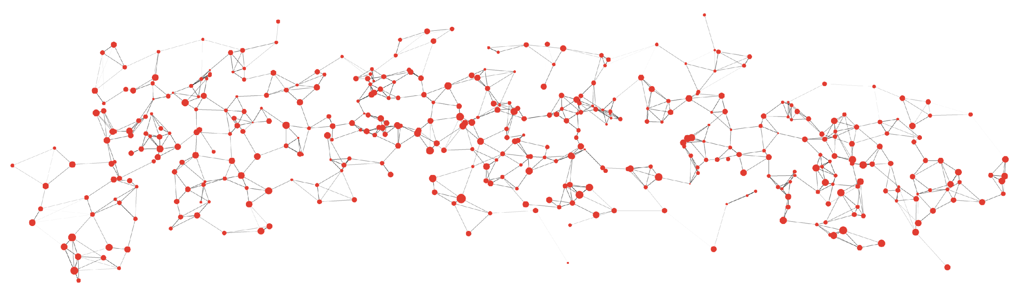


Generalized pairwise comparisons: A practical guide to the design and analysis of patient-centric trials
Johan Verbeeck PhD
johan.verbeeck@uhasselt.be
Data Science Institute
UHasselt - Belgium
Brice Ozenne PhD
brice.ozenne@nru.dk
Biostatistics & Neurobiology Research Unit
University of Copenhagen- Denmark

Slide 2
Author disclosures
We declare no conflicts of interest

Slide 3
Agenda
Motivating examples
Time-to-first event
Benefit-risk assessment
Multivariate outcomes of different types
Concept of GPC

Slide 4

Agenda
Motivating examples
Time-to-first event
Benefit-risk assessment
Multivariate outcomes of different types
Concept of GPC
Introduction to the package BuyseTest
Measures of treatment effect
Statistical inference
Examples, revisited

Slide 5
Agenda
Motivating examples
Time-to-first event
Benefit-risk assessment
Multivariate outcomes of different types
Concept of GPC
Introduction to the package BuyseTest
Measures of treatment effect
Statistical inference
Examples, revisited
Advanced Topics
Censoring
Stratification
Covariate adjustment
Trial design

Slide 6
Motivating examples

Slide 7
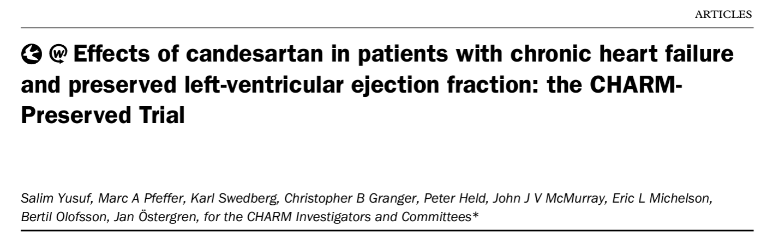
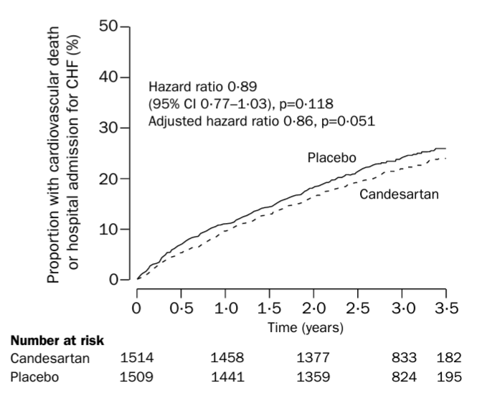
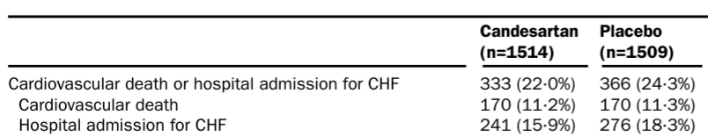
1. Composite of survival outcomes
Yusuf et al. Lancet (2003)
Notes:
an angiotensinreceptor blocker, candesartan, would be of benefit in patients with CHF and preserved LVEF

Slide 8
Issues with time-to-first event analyses
Events in time-to-first event composite
Candesartan Placebo
92 (54%) 90 (53%)
241 (100%) 276 (100%)
46% (158/340) of CV deaths are ignored
Yusuf et al. Lancet (2003)
Notes:
composite != sum of events; so several pts with more than 1 event; which means deaths are ignored (cannot ignore hopsitalization of course)
46% not used – but clinically most important

Slide 9
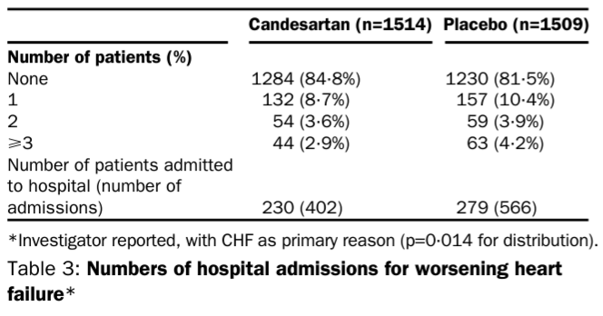
Issues with time-to-first event analyses
Emphasis is on time of event, rather than severity of event; i.e. a patient that has an hospitalization is worse than a patient dying 1 day later
Ignores repeated events (cannot count events; f.e. # hospitalizations)
Verbeeck et al. JACC (2023)
Verbeeck et al. EHJ:ACVC (2024)
Yusuf et al. Lancet (2003)

Slide 10
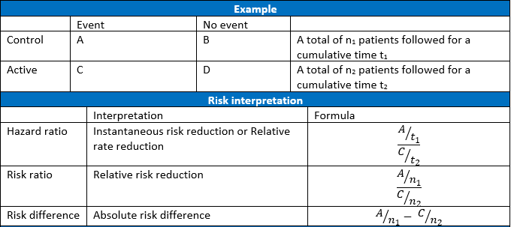
Issues with hazard ratio
Misinterpretation:
HR is time-dependent unless the hazard rates are proportional over time
Verbeeck et al. JACC (2023)
Verbeeck et al. EHJ:ACVC (2024)
Notes:
HR= ratio of the hazard rates (=instantaneous risk)
= a rate ratio or a relative rate reduction
≠ relative risk reduction

Slide 11
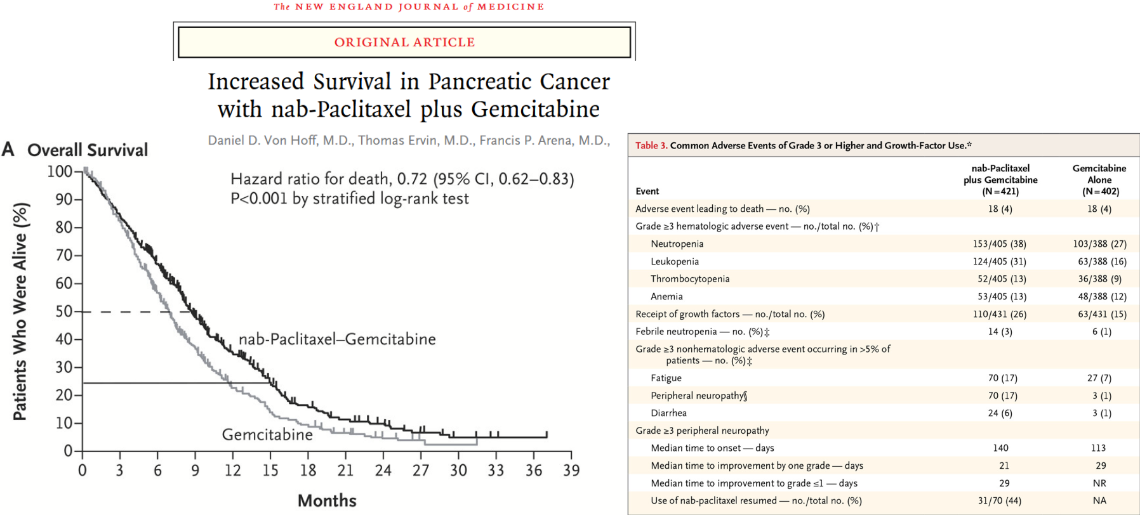
2. Benefit-Risk assessment
Do survival benefits outweigh the burden of the adverse-events?

Slide 12
Marginal Benefit-Risk analyses
Traditional analysis:
Benefit: log-rank test
difference in 1 year survival
example: 50% vs. 20%
Risk: chi-squared test
difference in proportion of patients
with events of grade 3 or higher
example: 30% vs 0%
ignores a possible association between benefit and risk
a) positive association: side effects may only occur when it prolongs life (never purely harmful treatment).
b) no association: treatment with two independent mechanisms, one acting on survival and another generating side effects.
c) negative association: treatment solely beneficial for some patients while solely harmful for other patients.

Slide 13
Benefit-Risk association
Treatment group (scenario a) |  | Response
 |  | Absent | Present | Total
Toxicity | Absent | 0.5 | 0.2 | 0.7
 | Present | 0 | 0.3 | 0.3
 | Total | 0.5 | 0.5 | 1
benefit: 0.3 vs. 0.3
Control group |  | Response
 |  | Absent | Present | Total
Toxicity | Absent | 0.8 | 0.2 | 1
 | Present | 0 | 0 | 0
 | Total | 0.8 | 0.2 | 1
- - - short life with toxicity | - short life without toxicity | + long life with toxicity | + + + long life without toxicity

Slide 14
Benefit-Risk association
Treatment group (scenario a) |  | Response
 |  | Absent | Present | Total
Toxicity | Absent | 0.5 | 0.2 | 0.7
 | Present | 0 | 0.3 | 0.3
 | Total | 0.5 | 0.5 | 1
benefit: 0.3 vs. 0.3
Control group |  | Response
 |  | Absent | Present | Total
Toxicity | Absent | 0.8 | 0.2 | 1
 | Present | 0 | 0 | 0
 | Total | 0.8 | 0.2 | 1
Treatment group (scenario b) |  | Response
 |  | Absent | Present | Total
Toxicity | Absent | 0.35 | 0.35 | 0.7
 | Present | 0.15 | 0.15 | 0.3
 | Total | 0.5 | 0.5 | 1
unclear: 0.15 + 0.15 + 0.15 vs 0.45
Treatment group (scenario c) |  | Response
 |  | Absent | Present | Total
Toxicity | Absent | 0.2 | 0.5 | 0.7
 | Present | 0.3 | 0 | 0.3
 | Total | 0.5 | 0.5 | 1
unclear: 0.3 + 0.3 vs 0.6
- - - short life with toxicity | - short life without toxicity | + long life with toxicity | + + + long life without toxicity

Slide 15
Sensible Benefit-Risk analyses
Benefit-risk balance depends on the association between response and toxicity
Traditional (marginal) analysis ignore this association
- marginal benefits and marginal risks cannot be combined (without strong assumptions)
- interpretation of the results is difficult
Upon deciding on a hierarchy of outcomes, e.g.:
a joint analysis of the benefit and the risk will provide value information.
- - - short life with toxicity | - short life without toxicity | + long life with toxicity | + + + long life without toxicity

Slide 16
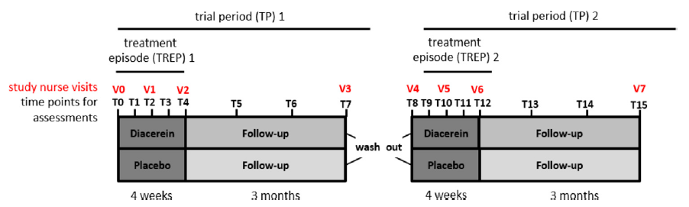
3. Multivariate outcomes of different types
Rare skin disease: Epidermolysis bullosa simplex
Formation of blisters under low mechanical stress
16 pediatric subjects treated with placebo and diacerin cream in a longitudinal cross-over trial
Wally et al. . J Am Acad Dermato (2018)
Notes:
Cytoskeleton protein misfolded – missing data – post 4 week Tx effect – blister reduction >40% (binary outcome) – difference in QoL (ctu)
Not specific for prioritized endpoints, but GPC

Slide 17
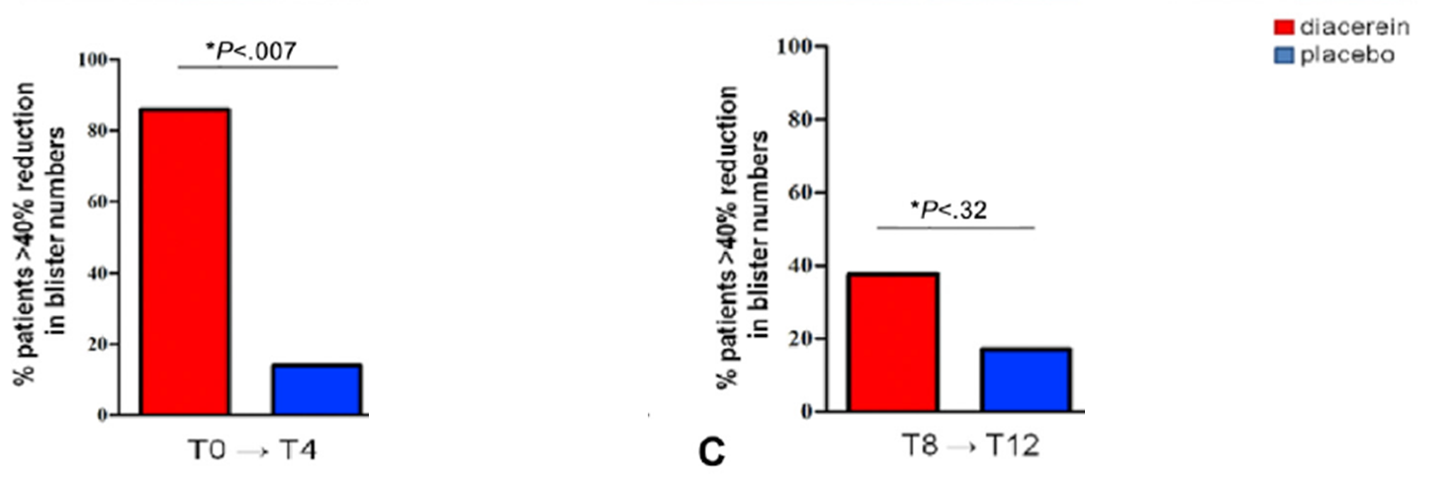
Inconclusive results - primary endpoint analysis
Primary endpoint:
>40% reduction in blisters compared to baseline (binary outcome ) at week 4
Barnard test (~Fisher exact test 2x2 table) per treatment period
Wally et al. . J Am Acad Dermato (2018)
Notes:
Longitudinal cross-over analyses with small samples in itself is an interesting problem, we’ll focus on a different issue

Slide 18
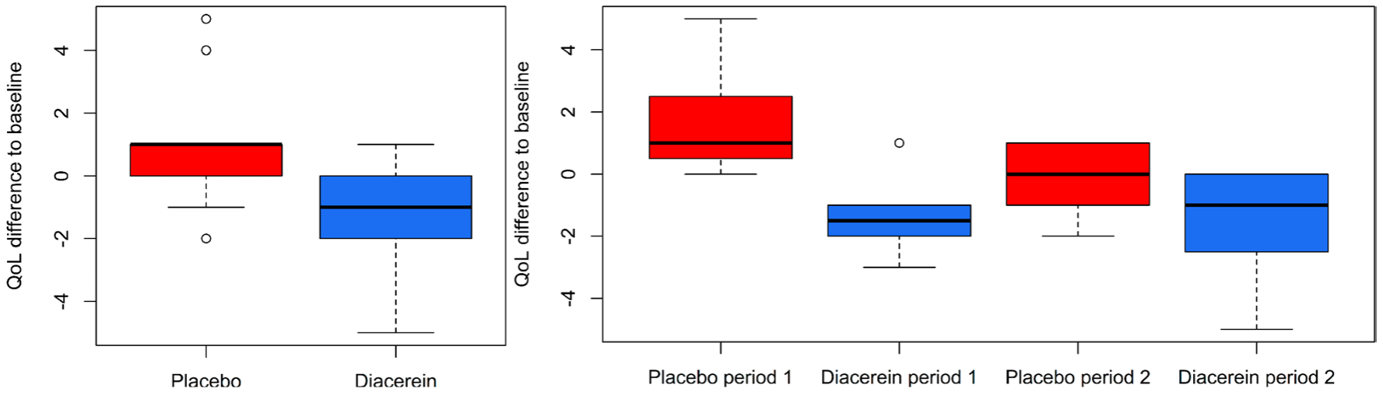
Patient-centric outcome ignored
Formation of blisters under low mechanical stress – affects QoL
How to combine information from QoL with blister information?
Wally et al. . J Am Acad Dermato (2018)
Verbeeck et al. OJRD (2023)

Slide 19
Concept of GPC

Slide 20
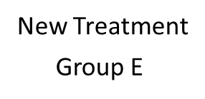
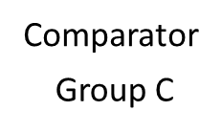
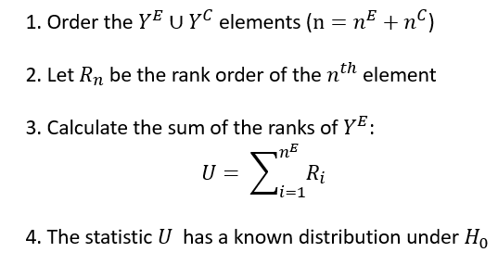


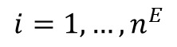
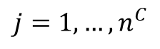
Wilcoxon rank-sum test
Wilcoxon. Biometrics 1945;1:80

Slide 21
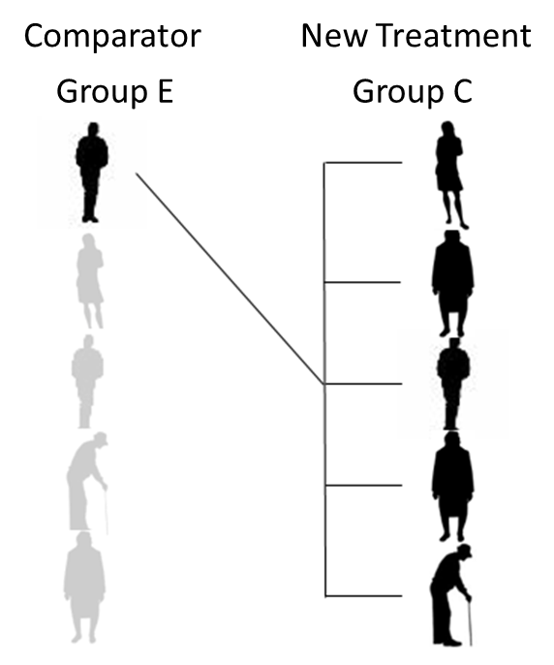
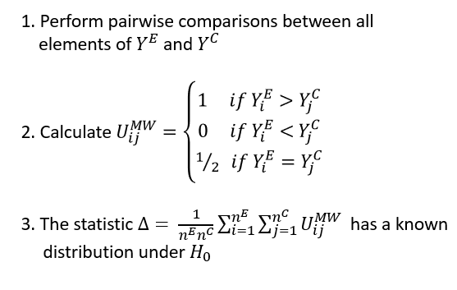
Mann-Whitney test
Mann & Whitney. Ann Math Stat 1947;18:50

Slide 22

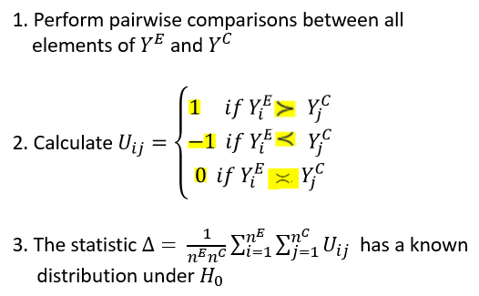
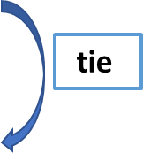
Generalized Pairwise Comparisons (GPC)
Highest ranked outcome
Middle ranked outcome
Lowest ranked outcome
Note: priorities may be patient-centric
Buyse. Stat Med 2010;29:3245
Pocock et al. Eur Heart J 2012;33:176

Slide 23
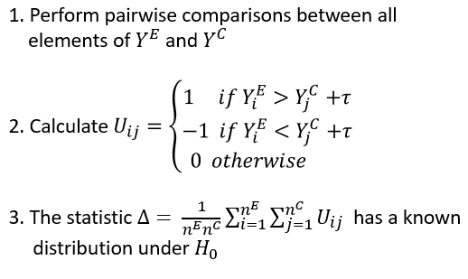
GPC – threshold of clinical similarity
Buyse. Stat Med 2010;29:3245

Slide 24
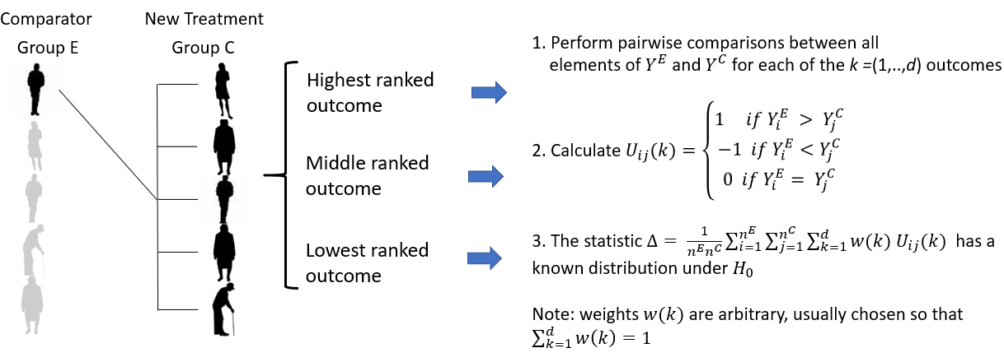
GPC – multiple weighted outcomes
O’Brien. Biometrics 1984;69:1079

Slide 25
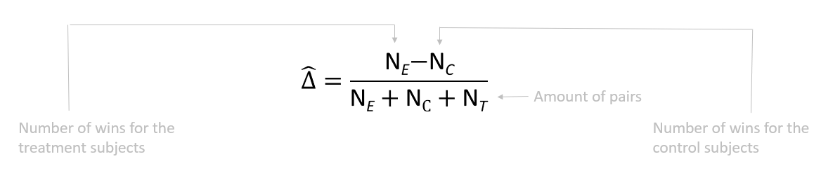
GPC statistics
Net treatment benefit (NTB)
Is a U-statistic
Buyse. Stat Med 2010;29:3245
Hoeffding. Ann Math Stat 1948;19:293

Slide 26
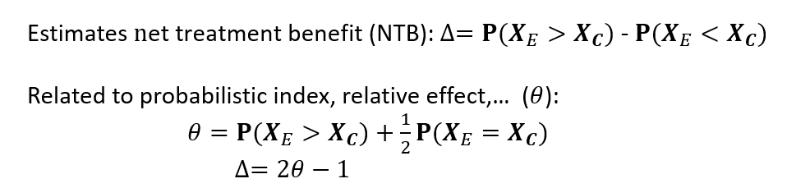
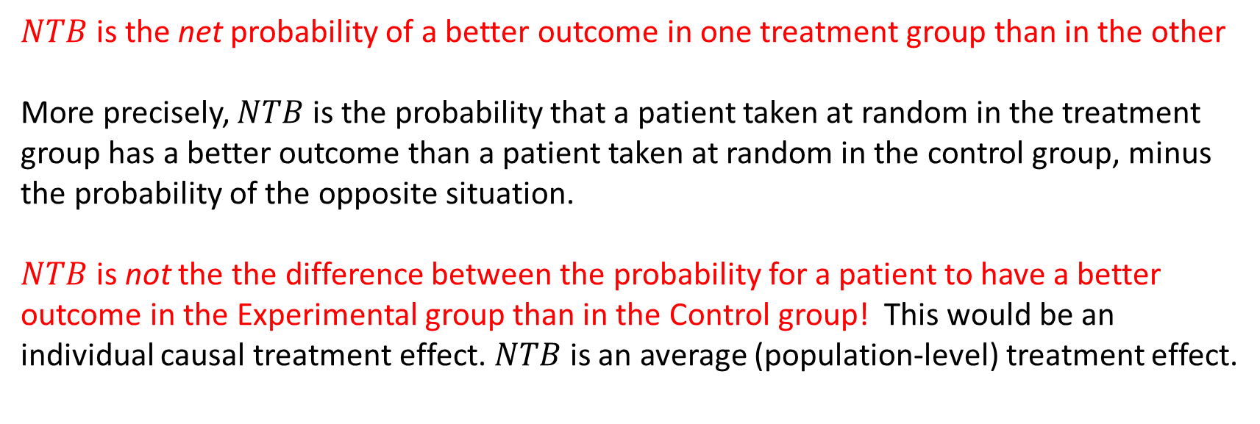
GPC statistics - Net treatment benefit
Buyse. Stat Med 2010;29:3245
Hoeffding. Ann Math Stat 1948;19:293

Slide 27
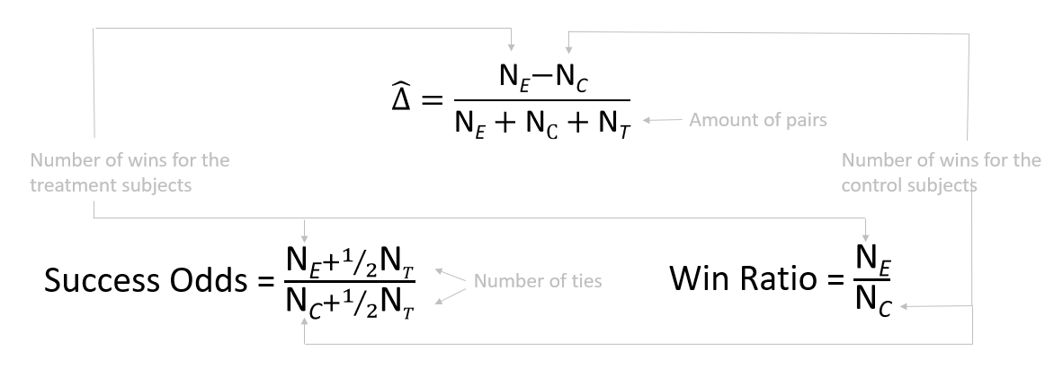
GPC statistics
Note : NTB = (SO-1)/(SO+1)
Buyse. Stat Med 2010;29:3245 Pocock et al. Eur Heart J 2012;33:176 Dong et al. Stat Biopharm Res 2020;12:99 Brunner et al. Stat Med 2021;40:3367

Slide 28
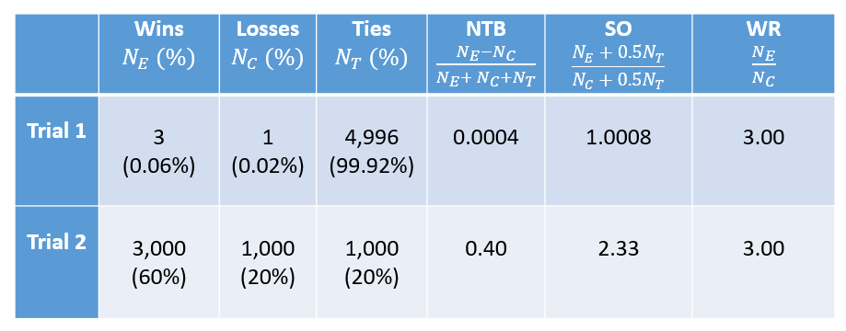
GPC statistics - differences
The WR ignores the ties or redistributes the ties according to the observed win/loss proportions -> overestimation of effect

Slide 29
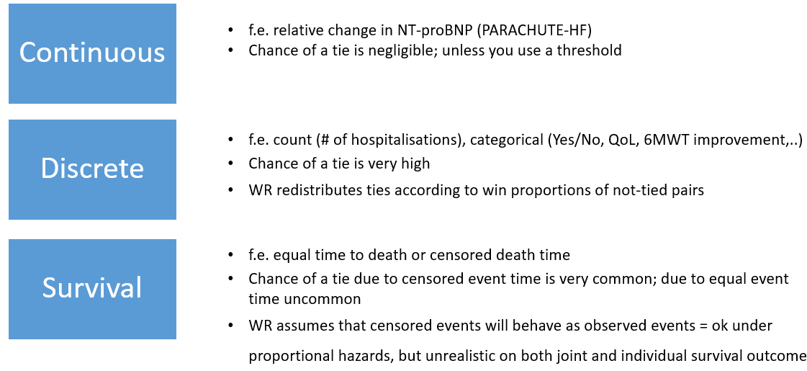
Consequences of redistributing ties

Slide 30
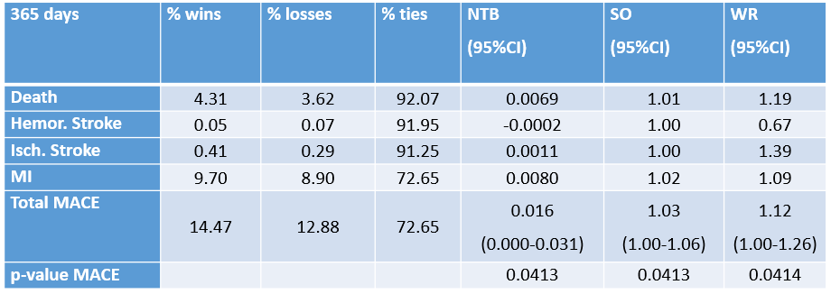
Additive decomposition of NTB

Slide 31
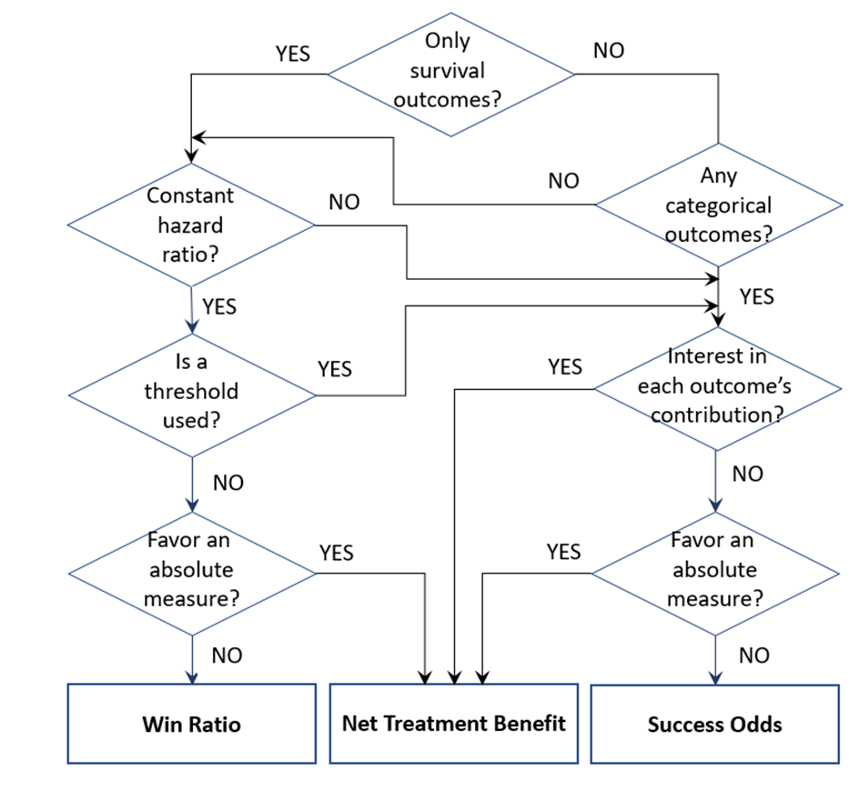
Guidance of GPC measures in clinical trials
Verbeeck et al. JACC 2023

Slide 32
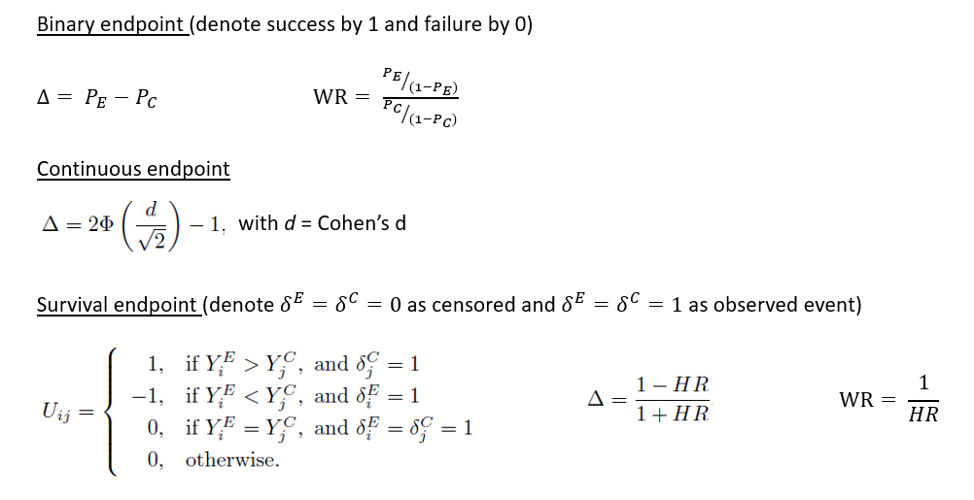
GPC – Links with conventional effect size measures for univariate outcomes
Gehan. Biometrika 1965;52:203
Notes:
diff in prob; odds ratio:

Slide 33
Questions? Break

Slide 34
Software for GPC
Part 1: Measures of treatment effect
code available at https://github.com/bozenne/tutorial-DagStat2025-GPC
file BuyseTest_intro.R
Notes:
+ intro software (10 slides)

Slide 35

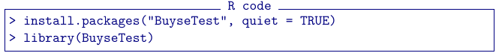

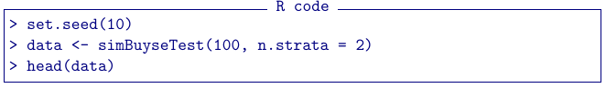
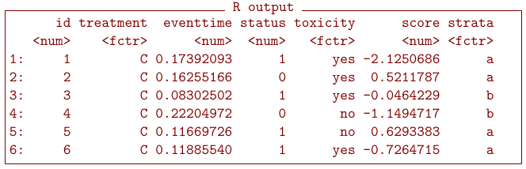
-package: BuyseTest
Installation
(require internet connexion)
Simulate data
100 subjects
2 treatment groups (C or T)
outcomes simulated independently
data.table format
(as.data.frame: convertion to data.frame)
Notes:
Workhorse : BuyseTest: requires a group indicator + outcomes (prioritized) and dataset
Default options via BuyseTest.options

Slide 36
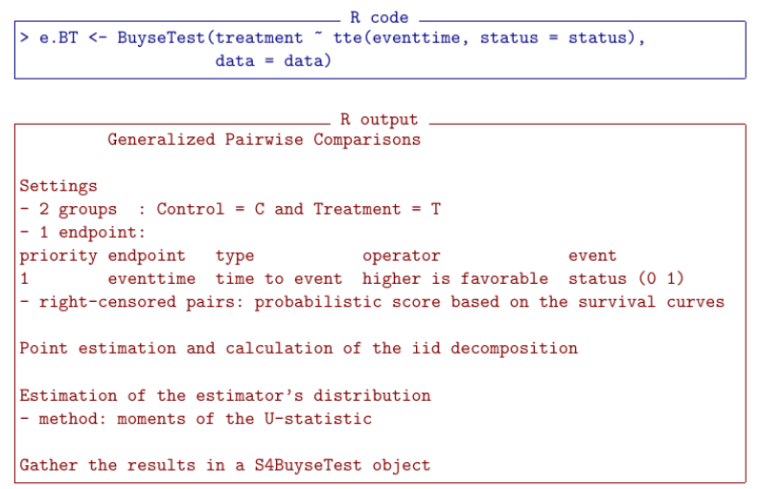
Formula interface
Left hand side: group
Right hand side: outcome(s)
time to event or tte or t
continuous or cont or c
binary or bin or b

Slide 37
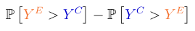
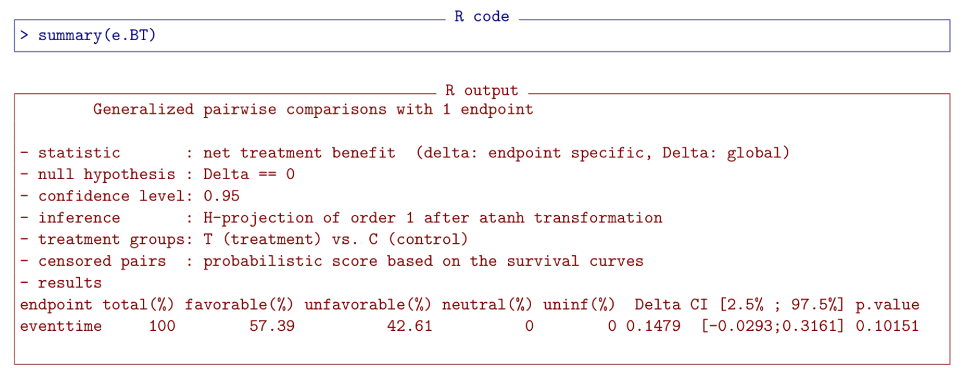
Output of the GPC procedure
Default: net treatment benefit

Slide 38
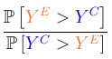
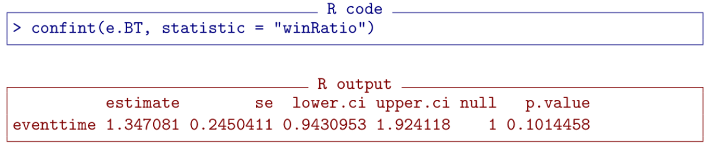
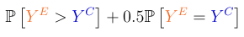
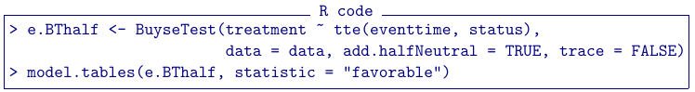

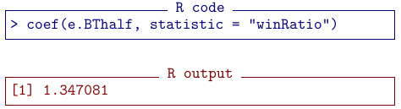
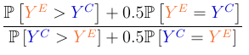
Other measures of treatment effect
Win ratio
argument statistic
Probabilistic index & win odds
re-run GPC adding
the contribution
of neutral pairs
no neutral pairs here
so win ratio = win odds

Slide 39
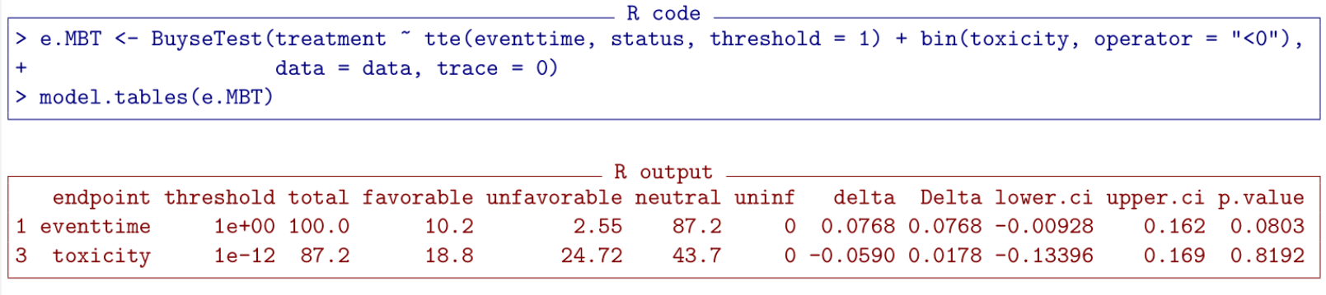
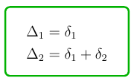
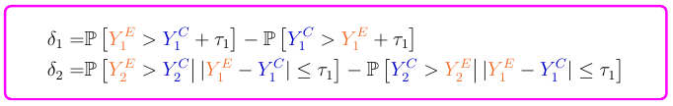
More options
Threshold (𝜏)
time to event outcomes
continuous outcomes
Operator
“<0” lower values are favorable
Multiple outcomes
separated by “+”
priority from left (highest)
to right (lowest)

Slide 40
Software for GPC
Part 2: statistical inference
code available at https://github.com/bozenne/tutorial-DagStat2025-GPC
file BuyseTest_intro.R
Notes:
+ intro software (10 slides)

Slide 41


Inferential methods in Buyse Test
H₀ : F_{e} = F_{c}
outcome distribution
permutation
u-statistic
bootstrap
H₀ : Δ = 0
Net Treatment
Benefit
studentized permutation
studentized bootstrap
u-statistic
transformation
no CI but exact
(under exchangeability)
asymptotically valid
studentized: Δ/σ_{Δ}
Anderson & Verbeeck
Mathematics 2023
resampling (slow)
analytic (fast)

Slide 42
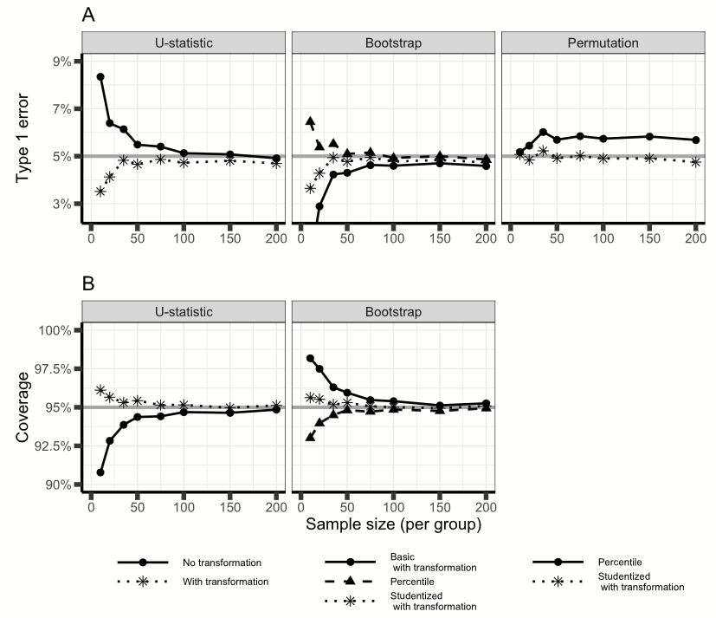
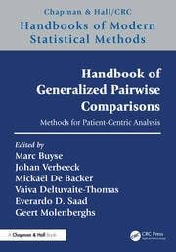
Results from a simulation study
heteroscedastic outcome
From
chapter 3

Slide 43
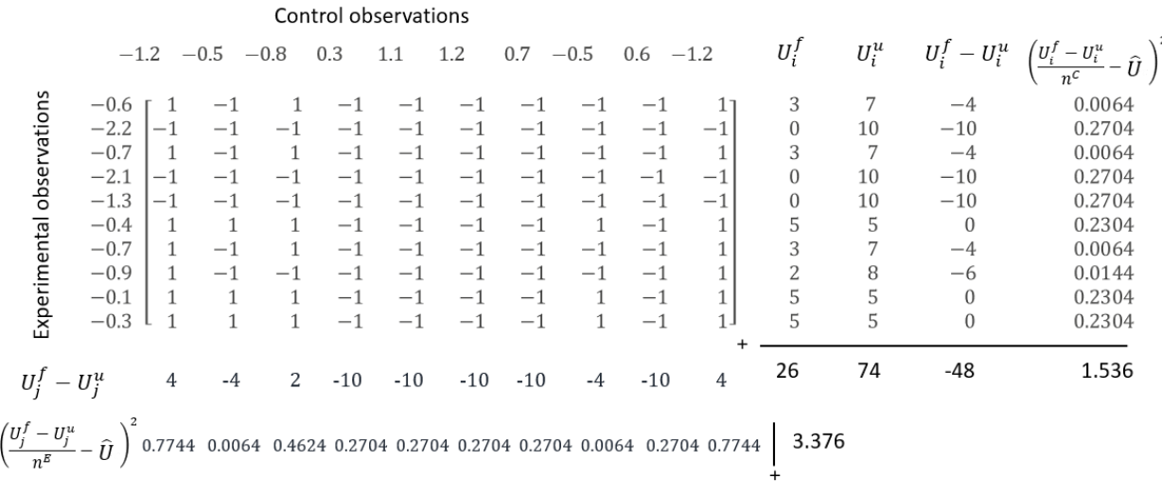
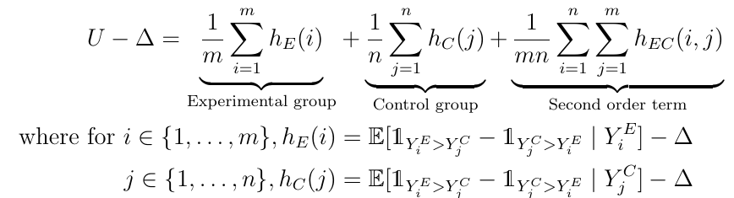
Inference based on U-statistic theory
Toy example
10 observation in each arm
Net Treatment Benefit (Δ)
estimated U=(26-74)/100=-0.48
Theory: H-decomposition
first order: similar to jackknife
second order: asymptotically
neglectable
Ozenne et al., SMMR, 2021

Slide 44
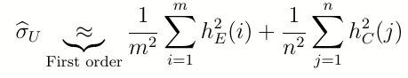
Inference based on U-statistic theory
Variance estimation:
first order:
1.536/100+3.376/100=0.04912
second order:
9*first order/10 + … = 0.0519
second order term in presence of ties
see Brunner et al., Stat. Papers, 2025.
2
Implementation:
combine intermediate results
(nearly no extra calculations)
use tanh⁻¹ transformation to be range preserving
- > improves small sample performance

Slide 45

Inference based on U-statistic theory
first order H-decomposition
(rescaled)

Slide 46



Inference based on permutations
Using resampling:
Permute the group labels (possibly within strata) in P different ways.
For each estimate the Net Treatment Benefit (Δ^{𝒫(1)},...,Δ^{𝒫(P)})
Evaluate the frequency of a more extreme result
Using an analytic formula (Anderson & Verbeeck, Mathematics, 2023)
matches Wilcoxon’s test p-value (no ties)
assumes normally distributed test statistic
currently not implemented for Gehan’s score
Notes:
Permutation only resampled implemented – not exact
Assume normal distibution of permuted NTB – ok for very small samples

Slide 47

Equivalence GPC and Wilcoxon rank sum test
(without continuity correction)

Slide 48
Argument method.inference in Buyse Test
Possible values:
"none"
"u statistic" (default)
"varexact permutation"
"permutation"
"studentized permutation"
"bootstrap"
"studentized bootstrap"
Additional arguments
transformation (T/F): in follow-up methods (e.g. summary)
n.resampling: number of samples
strata.resampling: stratified resampling
cpus: parallel evaluation
seed: for reproducibility
Change default behavior

Slide 49
Examples revisited

Slide 50

1. Time-to-first revisited: time-to-worst event
Or at least a simulated dataset resembling CHARM preserved (CHARM_sim.csv)
Events in time-to-first composite
Candesartan Placebo
92 (54%) 90 (53%)
241 (100%) 276 (100%)
Notes:
Simulated dataset has the same amount of events as CHARM preserved

Slide 51

Time-to-first vs. time-to-worst event
HR: 0.87 [0.75;1.01]
p-value: 0.0586
Notes:
But as said: we miss 46% of mortality

Slide 52

Time-to-first vs. time-to-worst event

Slide 53

Time-to-first vs. time-to-worst event

Slide 54

Time-to-first vs. time-to-worst event (with threshold)

Slide 55

2. Benefit-Risk assessment revisited
GPC analysis takes multiple prioritized outcomes into account:
Survival gain of at least 6 months
Worse side effect reduction by at least 2 grades
Survival gain of at least 1 month
Any reduction in worse side effect
Such an analysis is more clinical relevant and more powerful
- Illustration using a simulated dataset resembling the prodige trial

Slide 56



Analyses
Marginal
Hazard ratio: 0.778 [0.658,0.920]
Probability of toxicity ≥ 3
53.3% vs 60.6% (p = 0.033)
Joint analysis using GPC

Slide 57
Joint analysis using GPC
(simplified output)
Prioritized
outcomes
Favorable
pairs
Favor
Treatment
Favor
Control
Neutral
Contribution
NTB
Survival
Longer by ≥ 6 months
28.2%
56.2%
15.6%
12.7%
12.7% (P=0.0004)
Toxicity
Lower by 2 grades
13.0%
32.9%
10.3%
2.7%
15.4% (P<0.0001)
Survival
Longer by ≥ 1 month
5.1%
22.8%
5.0%
0.1%
15.4% (P=0.0002)
Toxicity
Lower
4.7%
12.3%
5.7%
-1.0%
14.4% (P=0.008)
Overall
51.0%
36.6%

Slide 58
GPC analysis of multivariate outcome
14.4% = (28.2% - 15.6%) + (13.0% - 10.3%) + (5.1% - 5.0%) + (4.7% - 5.7%)
NTB = NTB₁ + NTB₂ + NTB₃ + NTB₄
additive contributions of outcomes: facilitates interpretation
NTB₂ , NTB₃ , NTB₄ do not reflect marginal effects
they depends on previous outcomes (probability of neutral pair)
Win Ratio = 51.0% / 36.6% = 1.392
no additive or multiplicative decomposition
difficult to understand the contribution of each outcome

Slide 59




Sensitivity analysis
Sensitivity of the result to the choice of the threshold(s)
in other applications, the choice of the threshold can have substantial impact on the results

Slide 60

Sensitivity analysis

Slide 61

3. EB rare disease trial revisited
16 pediatric subjects treated with placebo and diacerin cream in a longitudinal cross-over trial (14 paired)
Patient-centric analysis: blister count and change in QoL at week 4
Uncertainty in blister counts
Notes:
Only week 4 since, QoL only measured at week 4 + uncertainty count

Slide 62

EB revisited:

Slide 63

EB revisited: Patient-centric outcome

Slide 64





Matched versus unmatched GPC
Konietschke et al. Electron J Stat (2012)
Fay et al. Stat Med. (2018)
Matsouaka SMMR (2022)
Verbeeck et al. OJRD. (2023)
Notes:
MOVER for CI; but not implemented in BuyseTest

Slide 65

EB revisited: Univariate insufficient evidence, but patient-centric analysis shows treatment effect

Slide 66

EB revisited: less evidence for count outcome

Slide 67

EB revisited: accounting for blister uncertainty
Notes:
Theshold = 0.5 (on a std scale: so uncertainty of half of the counts) – the higher the treshold to more you move to binary analysis

Slide 68


EB revisited: CI consistent with p-value in this case
permutation
Notes:
Need to use u-statistic for CI, consistent in this case, not necessarily so.

Slide 69
Advanced Topics

Slide 70


1. Censoring
End of study
End of study
Dropout censoring
Notes:
2 types of censoring

Slide 71
Gehan scoring rule (recap’)
T
C
U_{ij} = -1
U_{ij} = 0
U_{ij} = 1
informative pairs
T
C
U_{ij} = ?
U_{ij} = ?
U_{ij} = ?
uninformative pairs
analyzed using lower rank outcome(s)

Slide 72



Peron scoring rule (example)
time to event
(right-censored)
event type indicators
Only 1 out 4 individuals in the other group will survive up to the time of the observed event.
No survivor in the other group at the time of the observed event.

Slide 73

Peron scoring rule (formula)
pairwise score
event type indicators
0 censored
1 event
Large right-censored event time for the control arm
Large right-censored event time for the experimental arm
‘Similar’ right-censored event times
Péron et al. SMMR (2016)

Slide 74
Handling right-censoring with BuyseTest
Naïve approaches: (BuyseTest: scoring.rule = "Gehan“)
uninformative pairs = 0
biased but easy to carry out and preserve type 1 error control
Imputation approaches: (BuyseTest: scoring.rule = “Peron”)
estimate a probability per pair based on a survival model
default model: Kaplan-Meier stratified on treatment arm
estimation and uncertainty quantification is more complex
Add-hoc/other approaches: (BuyseTest: correction.uninf=1 or 2)
superior alternatives
Gehan Biometrika (1965)
Péron et al. SMMR (2016)
Ozenne et al. SMMR (2021)
Péron et al. Biometrical (2021)

Slide 75




Using build-in imputation approach
store pairwise score (U_{ij})
memory intensive

Slide 76
Several other corrections
See Deltuvaite-Thomas et al. Biometrical journal (2022) for an overview
Naïve approaches:
Gehan: uninformative pairs = 0
Harrell: ignore uninformative pairs
Imputation approaches: survival model
Latta: Kaplan-Meier (common to both arms)
Peron: Kaplan-Meier stratified on treatment arm
Efron: same but constrained to 0 at end of follow-up
De Backer: use extreme value tail model
Weighting approaches: inverse probability of censoring
Datta: pairs with censored event weight 0
Dong: ‘Gehan’-like alternative
Gehan Biometrika (1965)
Harrell et al. JAMA (1982)
Latta Biometrika (1977)
Péron et al. SMMR (2016)
Efron Proc 5th Berkeley Symposium on Math. Stat. and Proba. (1967)
De Backer Pharm Stat. (2023)
Datta et al. Scandinavian Journal of Statistics (2010)
Dong et al. Journal of Biopharmaceutical Statistics (2020)
The Kaplan Meier estimators (S_{KM}(t) event of interest, C_{KM}(t) censoring) satisfy:
S_{KM}(t) . C_{KM}(t) = number still at risk at time t+ / sample size
-> similarities between weighting and imputation: Efron/Datta Peron/Dong

Slide 77
(Personal) critic of the other corrections
implemented in BuyseTest
Naïve approaches:
Gehan: uninformative pairs = 0
Harrell: ignore uninformative pairs
Imputation approaches: survival model
Latta: Kaplan-Meier
Peron: Kaplan-Meier stratified on treatment arm
Efron: same but constrained to 0 at end of follow-up
De Backer: use extreme value tail model
Weighting approaches: inverse probability of censoring
Datta: pairs with censored event weight 0
Dong: ‘Gehan’-like alternative
not implemented in BuyseTest
biased (except PH case)
argument model.tte to provide an adequate survival model
‘discard’ information
equivalent to imputation approach
with un-natural survival models
Useful to handle informative censoring if covariates available
Unclear validity of the extension to multiple, correlated, endpoints

Slide 78

Using your own imputation approach
Latta
prodlim: Kaplan Meier estimator (possibly stratified)
survreg: parametric survival model (possibly with covariates)
rely on numerical integration

Slide 79

Performance in presence of drop-out
Reasonable for censoring below 50%
Deltuvaite-Thomas et al. Biometrical journal (2022)

Slide 80
What about administrative censoring?
Real life studies have finite follow-up time
- The tail of the survival function
is not (non-parametrically) identifiable
- May be needed to score some of the pairs!
Possible remedies:
make parametric assumptions (Efron, De Backer, Harrel, …)
switch to an easier estimand: restricted NTB to time 𝛤 (here 𝛤 =24 months)
rNTB = ℙ[min(X,𝛤)>Y] - ℙ[min(Y,𝛤)>X]
Piffoux et al. J Clin Epidemiol (2024)

Slide 81

2. Stratification
Buyse. Stat Med 2010;29:3245

Slide 82

Choice of weights
De Backer and Fay (to appear 2024)

Slide 83


Conditional vs. marginal estimates
De Backer and Fay (to appear 2024)

Slide 84



Slide 85

De Backer and Fay (to appear 2024)

Slide 86

3. Covariate adjustment
Notes:
Randomized studies: group is independent from covariates X

Slide 87

Conditional Models
1. Thas et al. J R Stat Soc Series B Stat Methodol. (2012)
2. Zhang et al. International Statistical Review (2019)
3. Mao et al. Biometrics (2021)
4. Jaspers et al. Stat. Med. (2024)
Notes:
Any link function can be taken
PIM: Jackknife empirical likeliihood
Mao extended conditional models to very specific limitations of proportional win fractions

Slide 88



Conditional Models: pim package
Childhood Respiratory Disease Study (CRDS) follows the pulmonary function (FEV) in 654 children of ages 3−19.
Interest: effect of smoking on FEV, corrected for age
Rosner Fundamentals of Biostatistics. (1999)
Notes:
forced expiratory volume (FEV), which is an index of pulmonary function measured = the volume of air expelled after one second of constant effort

Slide 89



Conditional Models: small sample pim
Toxicology study:
Investigate the impact of increasing doses of pyridine (0, 50,100, 250,
500, 1000 ppm) in 120 rats on organ weight corrected for sex and blood
chemistry.
10 rats per gender & dose
Probability that weight gain is smaller in 0 ppm group compared to 500 ppm = 7.9%
Jaspers et al. Stat. Med. (2024)
Notes:
Pyridie: toxic product causing liver, kidney and CNS issues + decreased gain in weiht
GEE with Morel small sample + Firth correction
Pairwise comparing doses + adjusted p-values Bnjamini-Hochberg
<50% meaning larger dose leads to lower gain in weight

Slide 90
Marginal Models
Single outcome:
Regression imputation estimator¹
Inverse probability of treatment weighted (IPTW) estimator²⁻⁴
Working on extensions to multivariate outcomes
1. Vermeulen et al. Stat Med. (2015)
2. Vermeulen et al. Int J Biostat. (2016)
3. Mao et al. Biometrika (2018)
4. Zhang et al. International Statistical Review (2019)
Notes:
in many studies the research question does not involve covariates, such that the natural effect size is of a marginal nature.

Slide 91
Designing a Trial

Slide 92
Example of a non-inferiority trial
De Backer, Clin Trials 2024
Aim:
Obtain approval for a as effective but safer drug
e.g. Acute Promyelocytic Leukemia: reduced dose treatment vs. full dose
Traditionally
Primary endpoint: Event-Free Survival (EFS) at 2 years
-> Expensive: large sample size required to meet a ‘narrow’ non-inferiority margin
-> Inefficient: key toxicity outcomes are relegated to secondary analyses
Could lead to unclear results:
- survival: lack of evidence for superiority of full dose
and non-inferiority of reduced dose
- toxicity: evidence in favor of reduced dose

Slide 93
Benefit-risk assessment using GPC
Prioritized outcome:
Event free survival with the non-inferiority margin as threshold (e.g. 1 month)
Severe side effects (e.g. grade 3 or 4)
… other considerations, e.g. number of hospital visits, cost.
Toxicity is only investigated among pairs of patients with similar survival
order of the outcomes reflects their importance (clinical, economical/logistic)
accounts for potential degradation of the survival with the reduced dose
Testing Net Treatment Benefit for reduced vs. full dose:
typically better powered
more meaningful: Does benefit-risk balance favor reduced dose?
Tannock et. al, Lancet Oncol 2024

Slide 94

De Backer, Clin Trials 2023

Slide 95
Challenges in designing trials with GPC
Definition of the estimand:
ordering of the outcomes
threshold(s) of clinical relevance
encoding of the outcome: typically more neutral pairs when categorical vs. continuous
more neutral pairs => more weight for later outcomes
interim analyses may lead to different estimands, e.g. with survival as first outcome more neutral pairs at interim compared to final due to shorter follow-up time
Simulations studies are typically required
GPC being non-parametric: no explicit formula
joint distribution required: hypothesis on the outcome dependence structure

Slide 96


Power/sample size calculation with BuyseTest
Outcome subject to outliers (e.g. t-distributed with few degrees of freedom)
Comparison in term of ranks, e.g. ℙ[Y^{E}>Y^{C}] vs ℙ[Y^{C}>Y^{E}] → Net Treatment Benefit
Not powered against heteroschedasticity → U-statistic inference
Step 1: define the data-generating mechanism via a function
data.frame
format

Slide 97

Power calculation with BuyseTest
Step 2: use the function powerBuyseTest to evaluate rejection rate
under the proposed data generating mechanism

Slide 98


Sample size calculation with BuyseTest
Step 2: use the function powerBuyseTest to approximate the sample size
(based on an asymptotic approximation, no accurate when only a sample sample is needed)

Slide 99


Slide 100


Slide 101

Advantages | Limitations
Patient-centric Flexible Multiple outcomes (e.g., prioritized) Higher power from multiple outcomes Thresholds of clinical relevance NTB easily interpretable effect measure Absolute effects needed for benefit / risk | Dangers of multiplicity Potential for data-driven analyses More complex interpretation Lower power for benefit / risk analyses Lack of familiarity WR not easily interpretable effect measure Relative effects constant across subsets

Slide 102

Brice Ozenne PhD
brice.ozenne@nru.dk
Biostatistics & Neurobiology Research Unit
University of Copenhagen- Denmark
Johan Verbeeck PhD
johan.verbeeck@uhasselt.be
Data Science Institute
UHasselt - Belgium

Slide 103
Old material
(removed)

Slide 104

Analytic formula for permutations

Slide 105
2. Inherently multivariate outcomes
Patients with locally advanced head & neck cancers may be treated with radiotherapy and cisplatin
Two thirds of patients develop severe oral mucositis (SOM)
SOM is a highly patient-relevant toxicity that
impacts quality of life
may result in treatment delays
There is currently no FDA-approved drug for the prevention of SOM
Anderson et al. (Submitted, 2024)

Slide 106

Severe Oral Mucositis

Slide 107
Traditional analysis
Compare incidence of SOM in patients receiving treatment vs. placebo
Example : ROMAN trial compared 241 patients treated with avasopasem manganese (AVA) vs. 166 patients receiving placebo (PBO)
Incidence of SOM : 64% PBO vs. 54% AVA
Absolute reduction in risk = 10%
P-value = 0.045
But…
Anderson et al. (Submitted, 2024)

Slide 108
Traditional analysis
Comparison of SOM incidence ignores
SOM severity (grade 4 much worse than grade 3)
SOM duration (from a couple of days to more than a month)
SOM onset time (later preferable because lower impact on radiotherapy)
SOM is inherently a multivariate outcome
Ignoring key features of SOM results in
loss of power
loss of clinical interpretability
Anderson et al. (Submitted, 2024)

Slide 109

Small sample inference with GPC: permutation
Histogram with fitted normal density curve (left) and normal Q-Q plot (right) of the exact permutation distribution of the net treatment benefit for a simulation of five subjects per arm.
Notes:
But no CI

Slide 110
2. Inherently multivariate outcome revisited
GPC analysis takes multiple prioritized outcomes into account:
WHO grade 4 SOM
WHO grade 3 SOM
Number of days of SOM (shorter better, threshold of 1 week)
Number of days to SOM (later better, threshold of week)
Such an analysis is more clinical relevant and more powerful

Slide 111
GPC analysis of multivariate outcome
Prioritized
outcomes
Favorable
pairs
Favor
Treatment
Favor
Control
Neutral
Contrib
NTB
Grade 4 SOM
Yes vs No
26%
58%
16%
10%
10% (P=0.044)
Grade 3 SOM
Yes vs No
14%
33%
11%
3%
13% (P=0.022)
Longer by ≥ 1 week
SOM duration
10%
17%
6%
4%
17% (P=0.0033)
Later by ≥ 1 week
4%
11%
2%
2%
Time to SOM
19% (P=0.0012)
Overall
54%
35%
19% (P=0.0012)

Slide 112
GPC analysis of multivariate outcome
NTB = 54% - 35% = 19%
NTB has straightforward interpretation
NNT (Number Needed to Treat) = 1/NTB
Contributions of all outcomes to NTB are additive
Win Ratio = 54% / 35% = 1.54
Interpretation of Win Ratio challenging (except for single outcome under proportional hazards)

Slide 113


GPC with two prioritized outcomes :
survival
frequency of cardiovascular-related hospitalizations

Slide 114

Interpretation ?

Slide 115

What is lacking in this analysis?
Marginal NTB for survival
Conditional NTB
for hospitalization

Slide 116



What is lacking in this analysis?
Marginal WR
for survival
(reciprocal of
hazard ratio)
Conditional WR
for hospitalization
(odds ratio)

Slide 117

Guidance of GPC measures in clinical trials
Verbeeck et al. JACC 2023

Slide 118
4. Benefit-Risk assessment revisited
Simple situation (as on slide 19):
binary efficacy outcome (1 = response, 0 = no response)
binary safety outcome (1 = no toxicity, 0 = toxicity)
GPC analyses of prioritized outcomes
Response > Toxicity
Toxicity > Response
Outcomes | Treatment | Control | Difference
Response rate (benefit) | 0.5 | 0.2 | 0.3
Toxicity rate (risk) | 0.6 | 0 | 0.6
Marginal benefit-risk difference |  |  | -0.3

Slide 119
4. Benefit-Risk assessment revisited
Actual trial : « IDEA France » for patients with colorectal cancer (@4 years follow-up)
binary efficacy outcome (1 = « response » = Disease-Free , 0 = DFS event)
binary safety outcome (1 = no Grade 3 / 4 neurotoxicity, 0 = Grade 3 / 4 neurotoxicity)
GPC analyses of prioritized outcomes
Response > Toxicity
Toxicity > Response
Outcomes | 3 months | 6 months | Difference
Disease-free (benefit) | 0.69 | 0.74 | - 0.05
Grade 3 / 4 neurotoxicity (risk) | 0.08 | 0.26 | - 0.18
Marginal benefit-risk difference |  |  | + 0.13

Slide 120
4. Benefit-Risk assessment revisited
install.packages("BuyseTest")
library(BuyseTest)
# Load IDEA dataset under independence of DFS and GR_3_4_CNS
setwd("C:/Users/mbuyse/OneDrive - IDDI/Google Drive/data/BENEFIT/IDEA")
data <- read.delim(file="Ch_01_1_5_IDEA_indep.csv",sep=",")
# Experimental arm is 3-month treatment (arm1=1), Control arm is 6-month treatment (arm1=0)
data$arm1 <- 1-data$arm
# GPC with DFS > GR_3_4_CNS
GPC <- BuyseTest(arm1 ~ b(Gr_3_4_PSN)+b(DFS),data = data)
summary(GPC)
# GPC with GR_3_4_CNS > DFS
GPC <- BuyseTest(arm1 ~ b(DFS)+b(Gr_3_4_PSN),data = data)
summary(GPC)
# Repeat with IDEA datasets under positive and negative association between DFS and GR_3_4_CNS

Slide 121

GPC benefit / risk analysis
0.064
0.051
0.007

Slide 122

GPC benefit / risk analysis
0.181
0.138
0.007

